Slide 1

Sentiment Analysis of News Articles for Predicting Economic Trends
Chang-Joon Lee

Slide 2
Motive – Why Are We Doing This?
MAXIMISE Profit $$$:
Buy LOW
Sell HIGH
Studies Have Shown:
“Significant Price Movement Immediately Following News Article Release”¹
Stock Market and Its Trends are EXTREMELY VOLATILE in Nature
Need NEW WAYS of Predicting Stock Trends
Gain
COMPETITIVE ADVANTAGE
^{1.} Schumaker, R.P. & Nick M.
“Analysis of Stock Price Movement Following Financial News Article Release.” Communications of the IIMA 16 (2018)

Slide 3
Pitfall of Conventional Trading Method
On September 30, 2004:
Pharmaceutical manufacturer Merck and Co. voluntarily RECALLED their profitable drug Vioxx.
This recall resulted in a 27% STOCK DECLINE and a $27 billion dollar equity loss in one day (BusinessWeek, 2004).
Automated HFT algorithms, oblivious to the recall, MISINTERPRETED the price drop as a buying opportunity and LOST millions of dollars before they could be stopped.
Sentiment Analysis Can:
Supplement Trade Decision Making
Used for Stock Management
HFT : High-Frequency Algorithm Trading

Slide 4
Objective
Business Objective:
Adjust Trading Strategy Based on Sentiment of Daily News Articles
For This Project:
Build a Predictive Model based on Natural Language Processing that can CORRECTLY predict:
POSITIVE Sentiment (BUY)
NEUTRAL Sentiment (STAY)
NEGATIVE Sentiment (SELL)
Modelling Objective:
AUTOMATE:
GATHER: News Articles
CLASSIFY: Sentiment

Slide 5
How Will We Do This?
1. Gather News Articles
(New York Times API)
Business/Finance News Articles from New York Times from the 1990 - 2000s related to “Stock Market” or “S&P 500”
- Total of ~17,000 articles
Manually Labelled Using 3 Methods:
Manual labelling using Harvard GI & Loughran-McDonald Lexicon Dictionaries
TextBlob Polarity Score
Vader Compound Score
These 3 scores are aggregated to get the final labels.
Samples of labelled articles are manually checked for accuracy.
2. Label the Sentiment of Each Article
Tokenisation & Lemmatisation using spaCy:
Remove all words in the stop words list.
Remove all punctuations.
EXCEPT all words that are either:
Determiner (“some”, ”this”, “each”)
Negate (“not”, “n’t”)
Noun phrase as adverbial modifier
(“6 feet long – “long”, “feet”)
Word Vectorisation (Bag-of-Words):
Count
TF-IDF
Word2Vec
Machine Learning Algorithms:
Logistic Regression
Support-Vector Machine
Gaussian Naïve Bayesian Model
3. Feature Engineering using NLP
4. Model Training & Testing

Slide 6
Sentiment Labelling
Dow Jones industrial average gains 10556 points or 11 percent to close at record 964332 Standard & Poors 500 - stock index rises 536 points or four - tenths of 1 percent to record 127509 Nasdaq composite index climbs 1832 points or eight - tenths of 1 percent to record 234441…
POSITIVE
(0.17)
in seesaw trading and with heavy volume the stock market closed mixed yesterday as traders persuaded themselves that another rate increase by the federal reserve board was imminent…
NEAUTRAL
(-0.09)
senior economic officials in China hold series of private meetings then emerge with public view of financial crisis engulfing other Asian countries they urge Chinese bankers to try to avert kind of panic that sent curencies and stock markets tumbling elsewhere…
NEGATIVE
(-0.19)

Slide 7
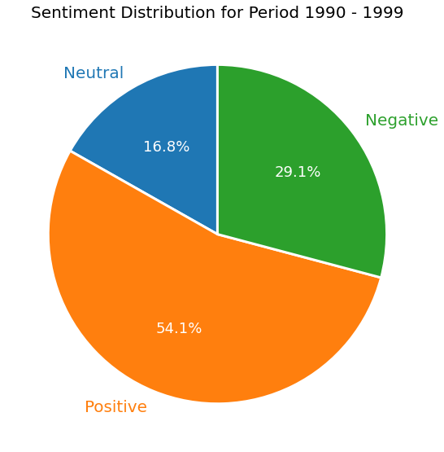
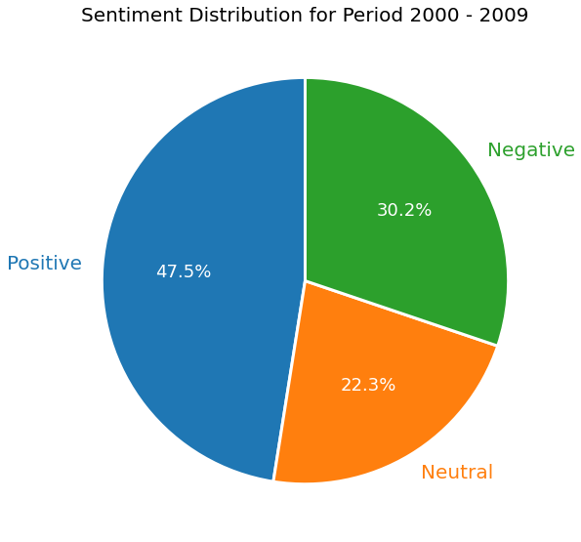
EDA – Overall Sentiment
Majority of the news articles were POSITIVE (54%) during the 90s, due to the ECONOMIC BOOM during the time.
NEGATIVE and NEUTRAL sentiments INCREASED by 6% in the 2000s, most likely due to the GREAT RECESSION of 2007.
1990s
2000s

Slide 8
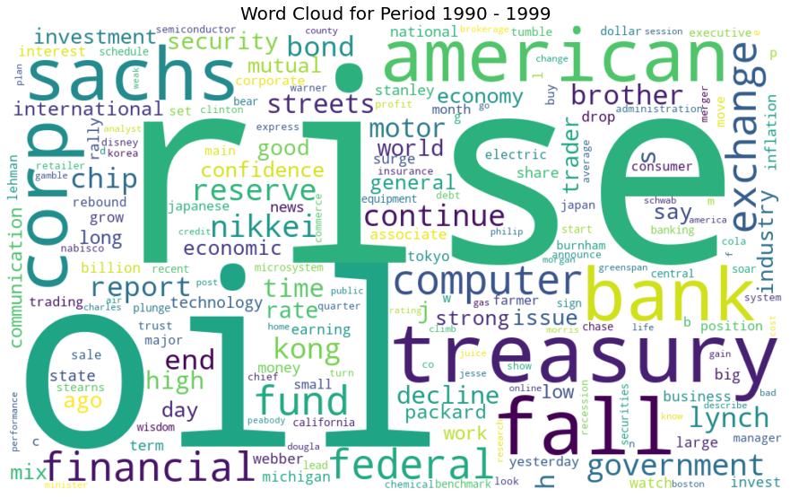
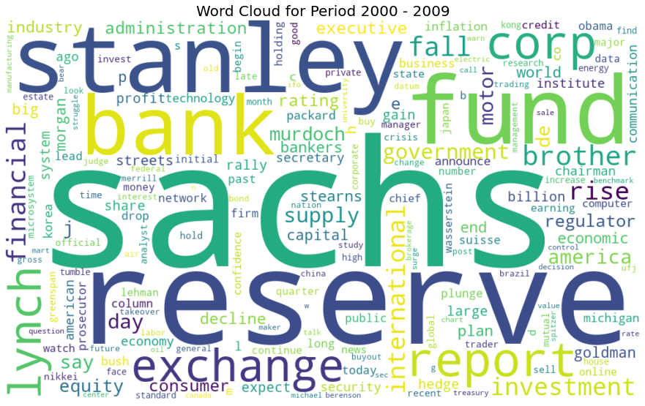
EDA – Word Clouds
1990s
2000s

Slide 9
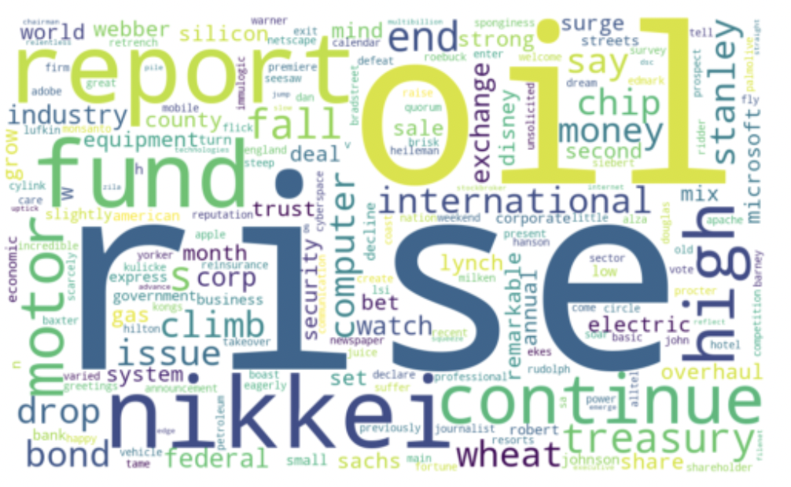
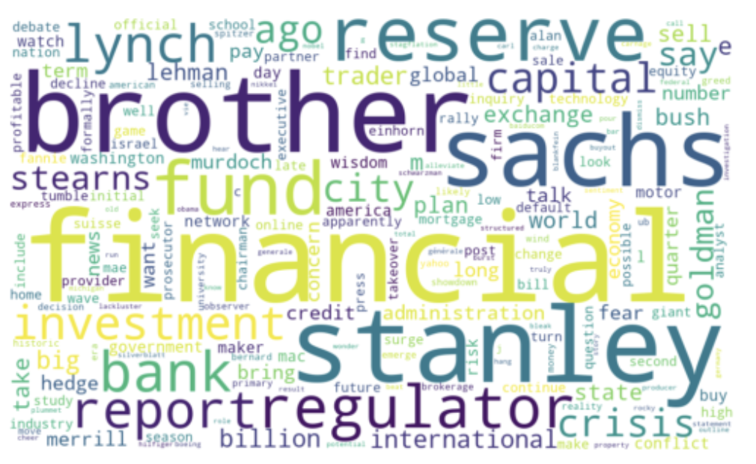
EDA – Word Clouds
1997
2008

Slide 10
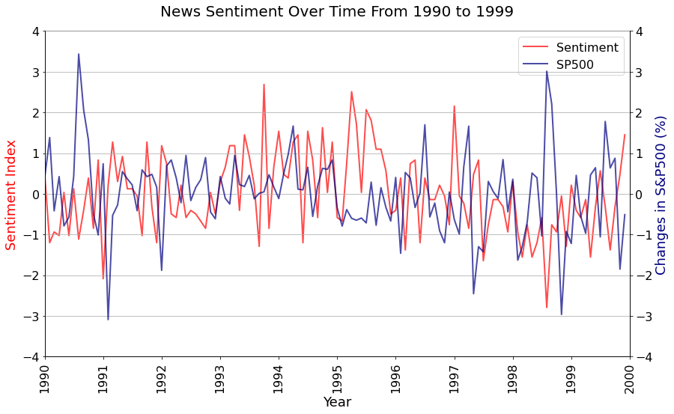
EDA – Stock Prices vs Sentiment
Normalised monthly sentiment vs normalised monthly change in stock price.
Slight misalignment between the two curves.
Possible delay in how news sentiment affect the stock market.

Slide 11
Machine Learning
1.Spit the Dataset
2.Feature Extraction
3. Machine Learing
4. Final Test
Hyperparameter Tuning
Max. Number of Features
Hyperparameter Tuning
C Value (Regularisation)
1990s Data
Count Vectorisation
Logistic Regression
2000s Data
Train (80%) Validation (20%)
Test (100%)
TF-IDF Vectorisation
SVM
Word2Vec
Gaussian NB

Slide 12
ML – Training & Validation Scores
Count Vector
Model | C Value | Train | Validation
Log | 0.001 | 0.643 | 0.624
SVM | 0.001 | 0.658 | 0.653
NB | - | 0.605 | 0.562
Best Model: SVM with TF-IDF
TF-IDF
Model | C Value | Train | Validation
Log | 0.1 | 0.722 | 0.680
SVM | 0.5 | 0.828 | 0.775
NB | - | 0.636 | 0.588
Can We IMPROVE?
Word2Vec
Model | C Value | Train | Validation
Log | 1000 | 0.657 | 0.618
SVM | 1000 | 0.699 | 0.676
NB | - | 0.521 | 0.513
ADAPTIVE BOOSTING

Slide 13
Adaptive Boosting
Model | n | Learning Rate | Train | Before Boosting | After Boosting
Count | 20 | 0.1 | 0.744 | 0.653 | 0.714
TF-IDF | 20 | 0.1 | 0.809 | 0.775 | 0.755
Word2Vec | 5 | 0.1 | 0.885 | 0.676 | 0.768
Best Model:
SVM with TF-IDF
(unboosted)
Count and Word2Vec Model improved by 10 – 15%.
TF-IDF Model performed slightly worse than before boosting.
It is likely TF-IDF could improve to higher score if we increase the number of estimators, but at a higher computational cost.
n: Number of Estimators

Slide 14
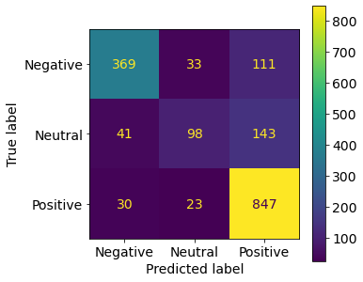
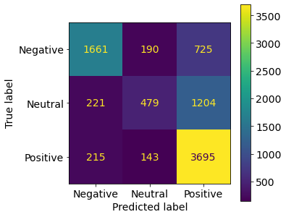
Final Testing
Validation
Test
Accuracy = 0.78
Positive Recall = 0.94
Neutral Recall = 0.35
Negative Recall = 0.72
Accuracy = 0.68
Positive Recall = 0.91
Neutral Recall = 0.25
Negative Recall = 0.64

Slide 15
Conclusion & Recommendations
Summary:
The final predictive model chosen is SVM model using TF-IDF vectorisation with C = 0.5 (soft margin).
The final test score using data from 2000s is 0.68.
Recommendations:
Better ways of labelling the news article sentiments (lexicon dictionaries, scoring system, squashing function to aggregate the final score for each label.)
Two-class (positive & negative) labels rather than three classes, since the model was ineffective in predicting the neutral class.
Better ways of filtering out texts and pre-processing the filtered texts (e.g. use entity recognition)

Slide 16
THANK YOU

